Slide 1

Class Color declares methods and constants for manipulating colors in a Java program.
The predeclared color constants are summarized in Fig. 13.3, and several color methods and constructors are summarized in Fig. 13.4.
Two of the methods in Fig. 13.4 are Graphics methods that are specific to colors.
© Copyright 1992-2015 by Pearson Education, Inc. All Rights Reserved.

Slide 2
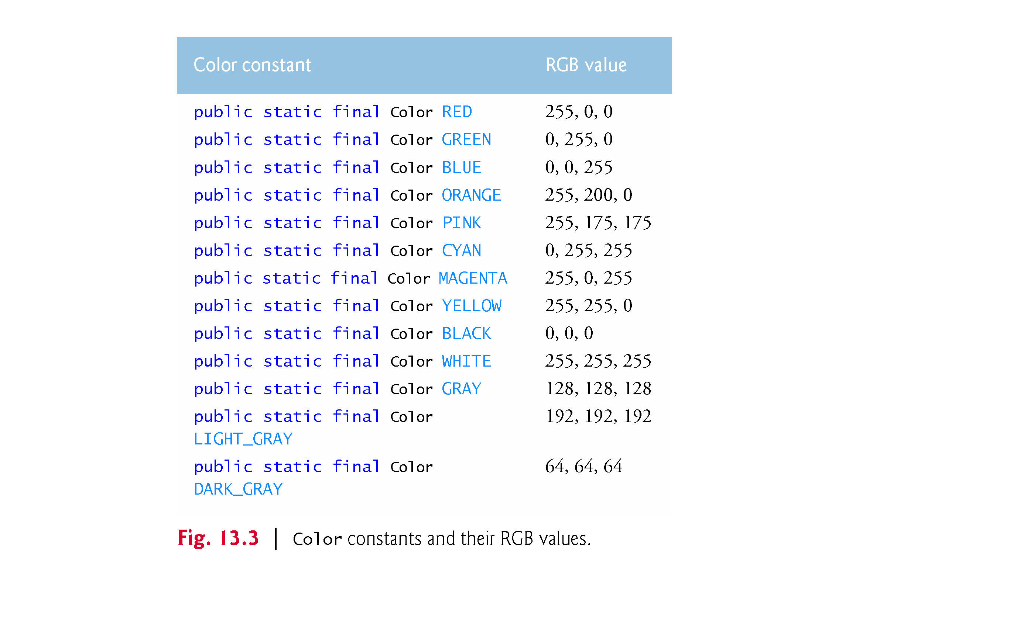
© Copyright 1992-2015 by Pearson Education, Inc. All Rights Reserved.

Slide 3
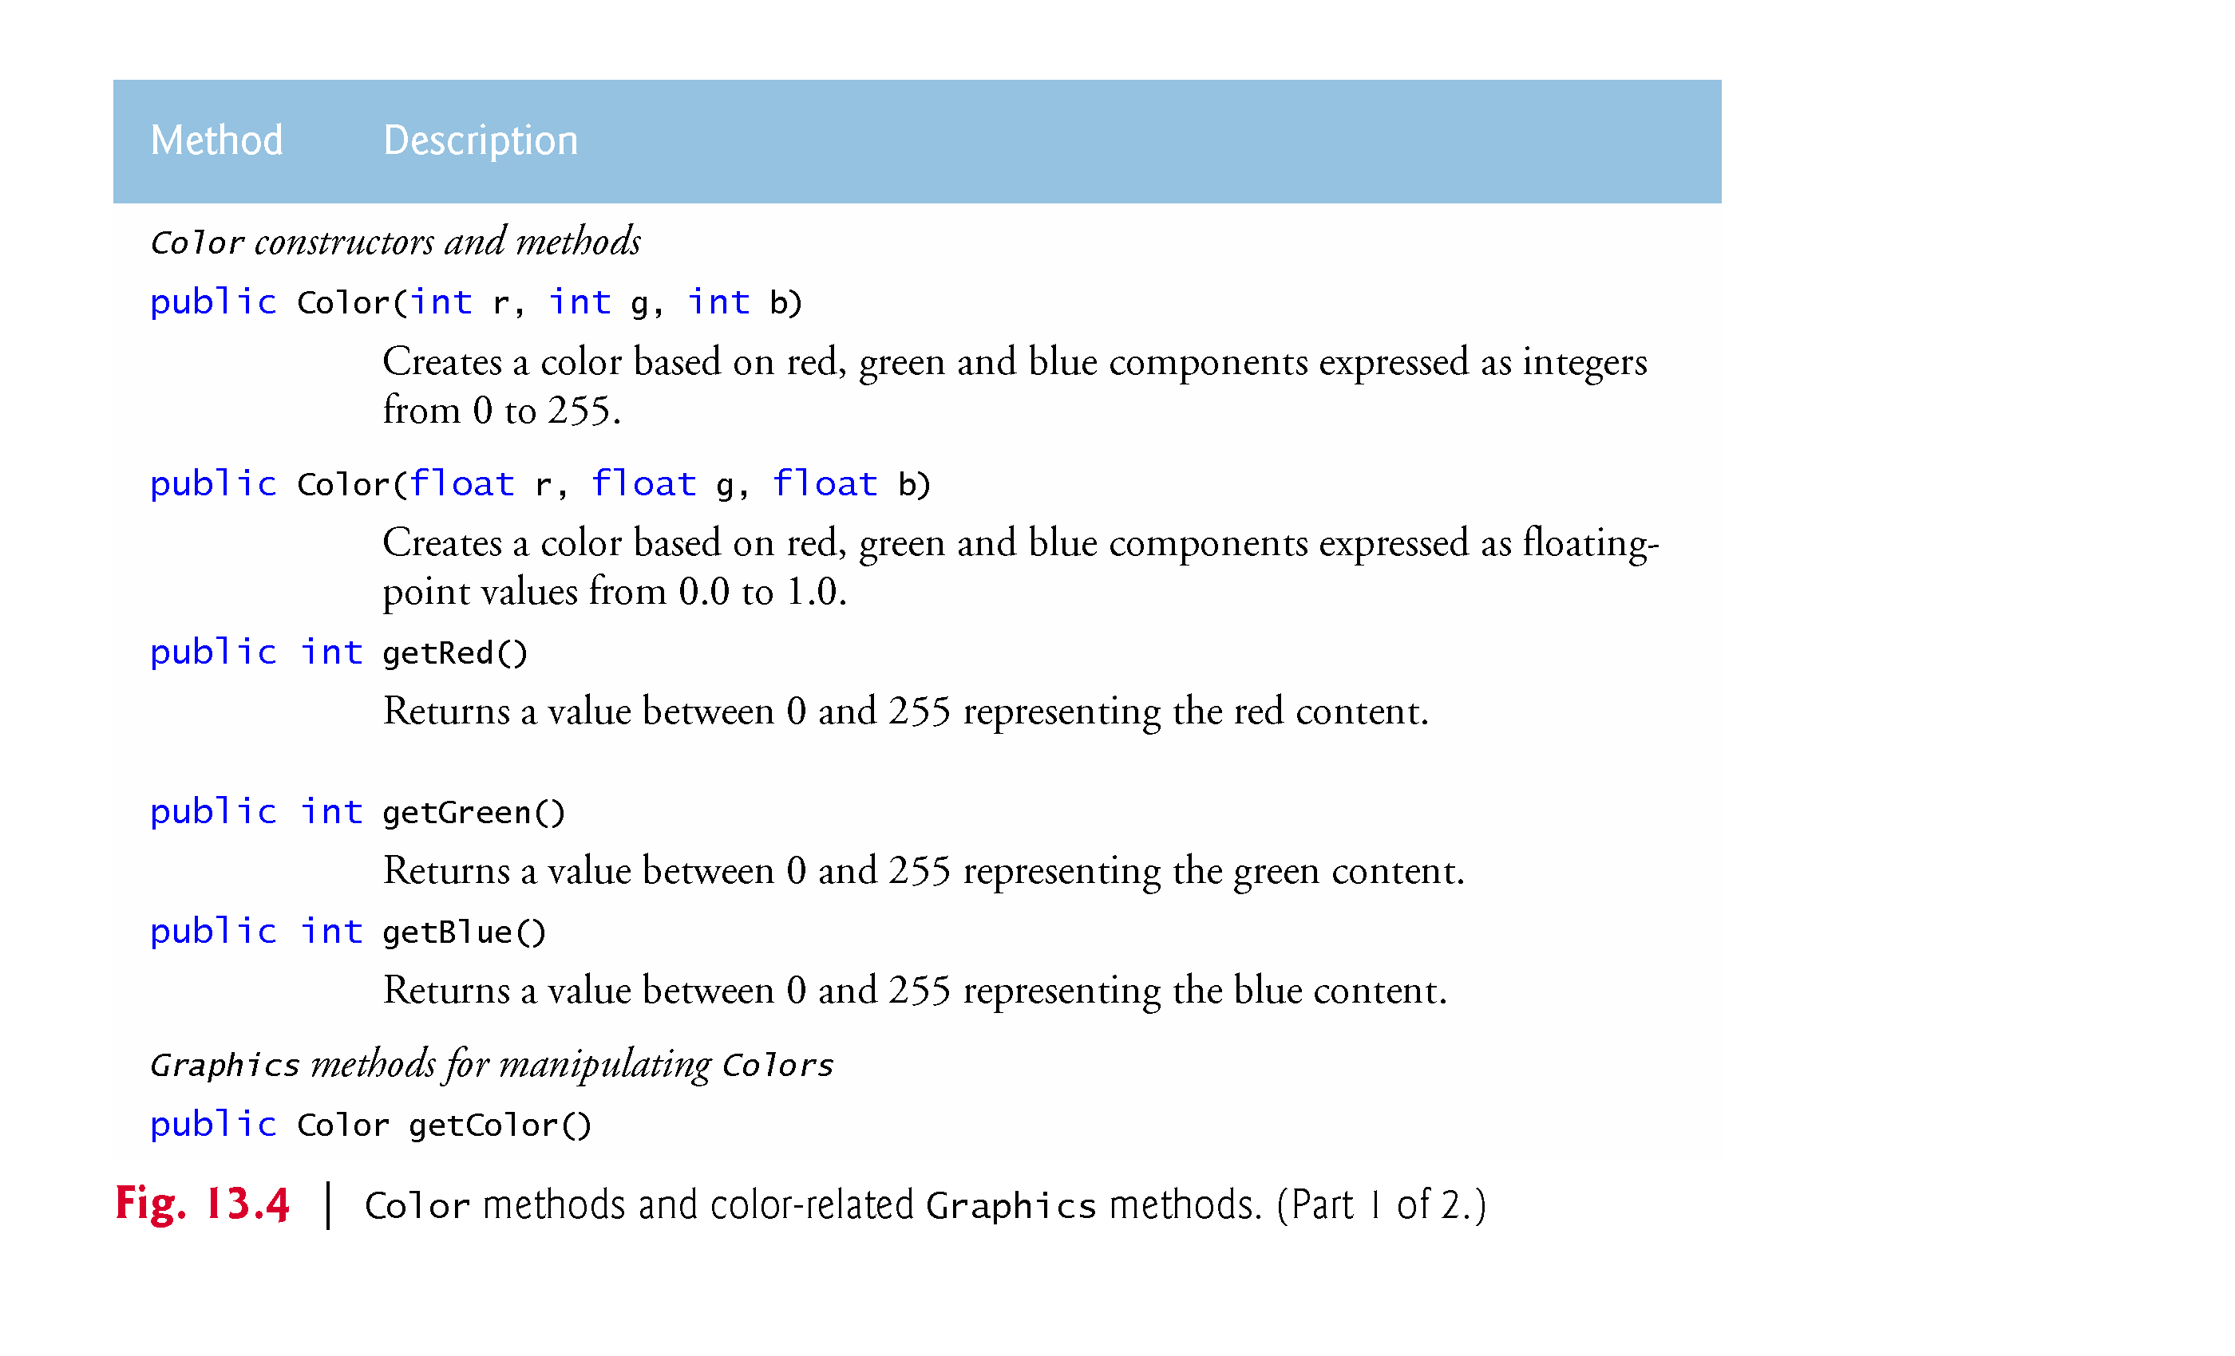
© Copyright 1992-2015 by Pearson Education, Inc. All Rights Reserved.

Slide 4
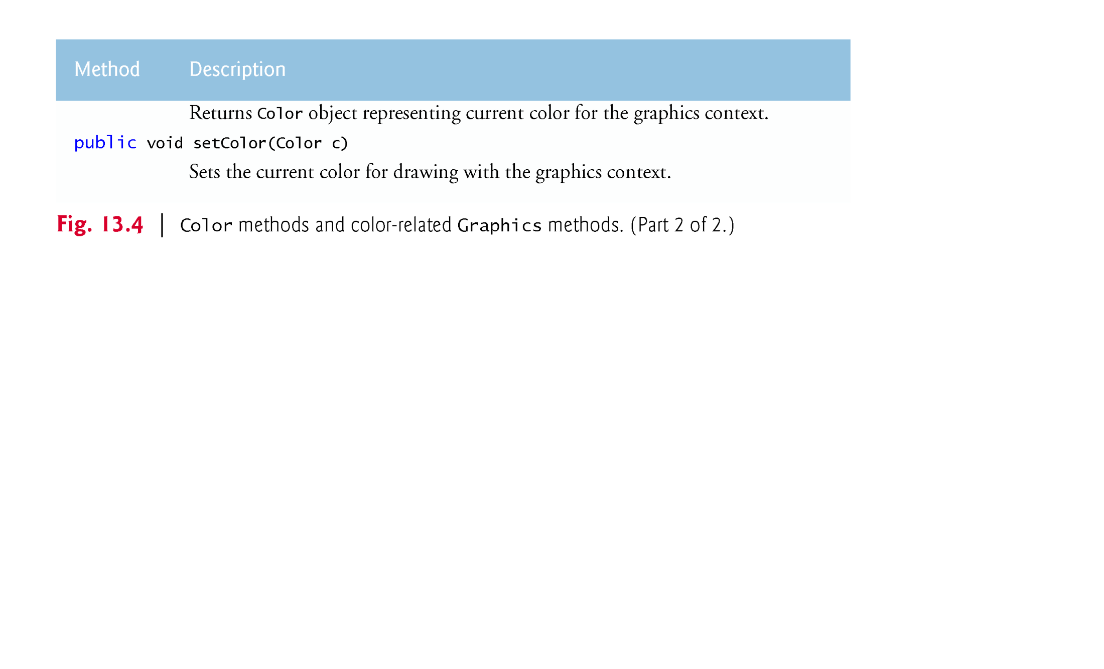
© Copyright 1992-2015 by Pearson Education, Inc. All Rights Reserved.

Slide 5

Graphics method fillRect draws a filled rectangle in the current color.
Four arguments:
  The first two integer values represent the upper-left x-coordinate and upper-left y-coordinate, where the Graphics object begins drawing the rectangle.
  The third and fourth arguments are nonnegative integers that represent the width and the height of the rectangle in pixels, respectively.
A rectangle drawn using method fillRect is filled by the current color of the Graphics object.
Graphics method drawString draws a String in the current color.
© Copyright 1992-2015 by Pearson Education, Inc. All Rights Reserved.

Slide 6
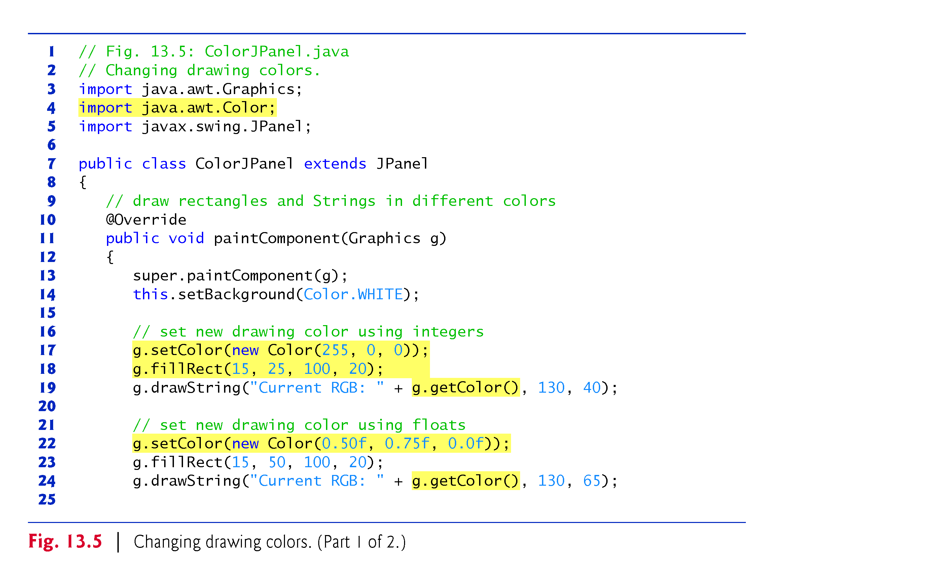
© Copyright 1992-2015 by Pearson Education, Inc. All Rights Reserved.

Slide 7
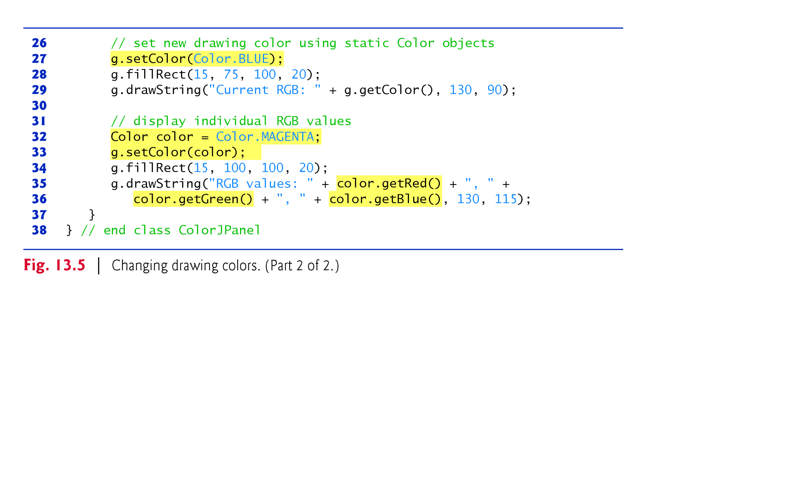
© Copyright 1992-2015 by Pearson Education, Inc. All Rights Reserved.

Slide 8
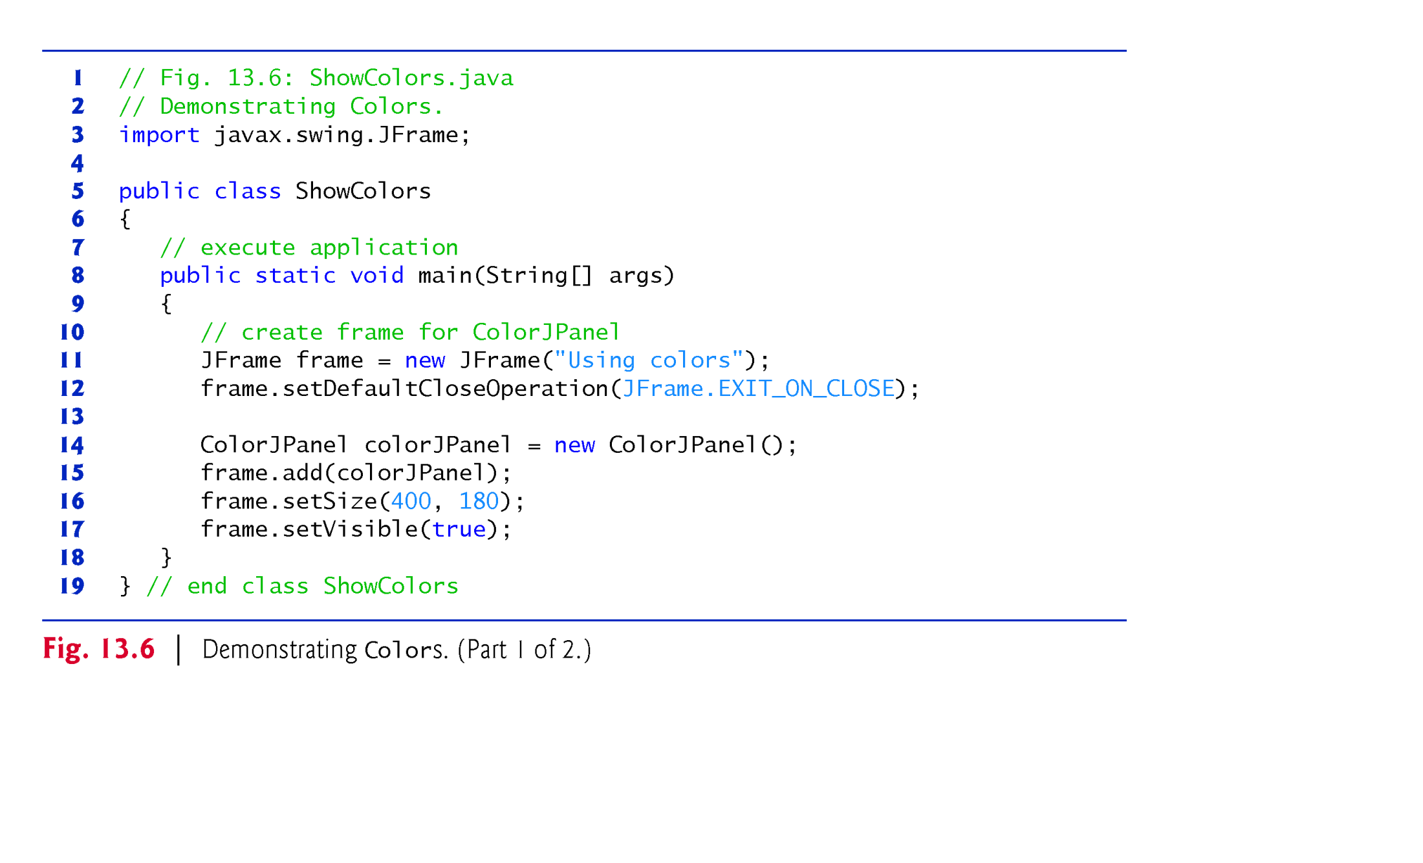
© Copyright 1992-2015 by Pearson Education, Inc. All Rights Reserved.

Slide 9
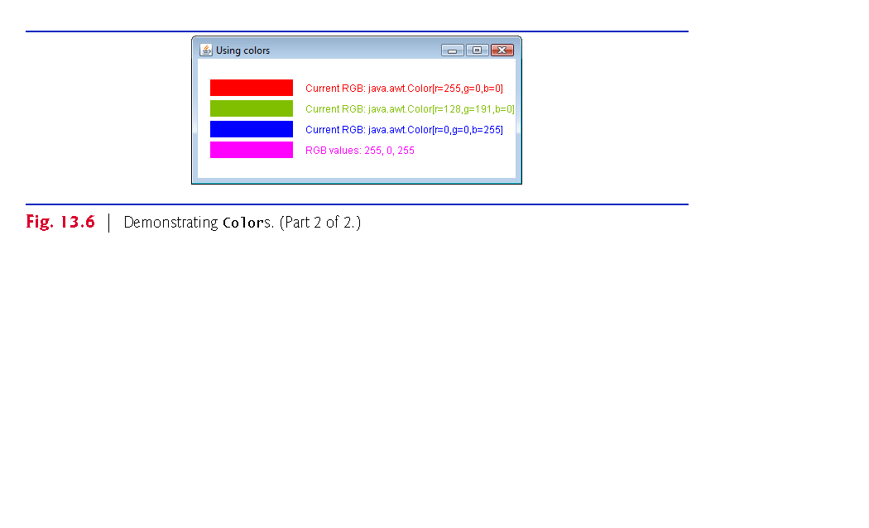
© Copyright 1992-2015 by Pearson Education, Inc. All Rights Reserved.

Slide 10
The JColorChooser component (package javax.swing) enables application users to select colors.
JColorChooser static method showDialog creates a JColorChooser object, attaches it to a dialog box and displays the dialog.
  Returns the selected Color object, or null if the user presses Cancel or closes the dialog without pressing OK.
  Three arguments—a reference to its parent Component, a String to display in the title bar of the dialog and the initial selected Color for the dialog.
Method setBackground changes the background color of a Component.
© Copyright 1992-2015 by Pearson Education, Inc. All Rights Reserved.

Slide 11
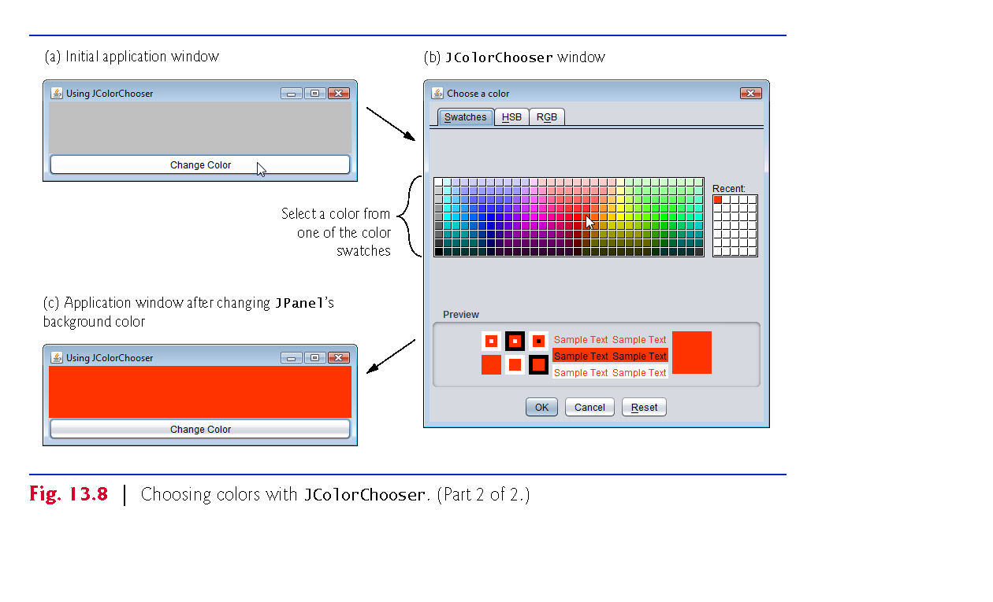
© Copyright 1992-2015 by Pearson Education, Inc. All Rights Reserved.

Slide 12
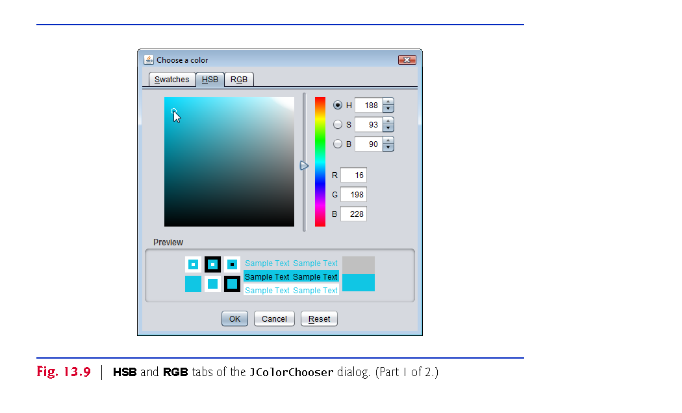
© Copyright 1992-2015 by Pearson Education, Inc. All Rights Reserved.

Slide 13
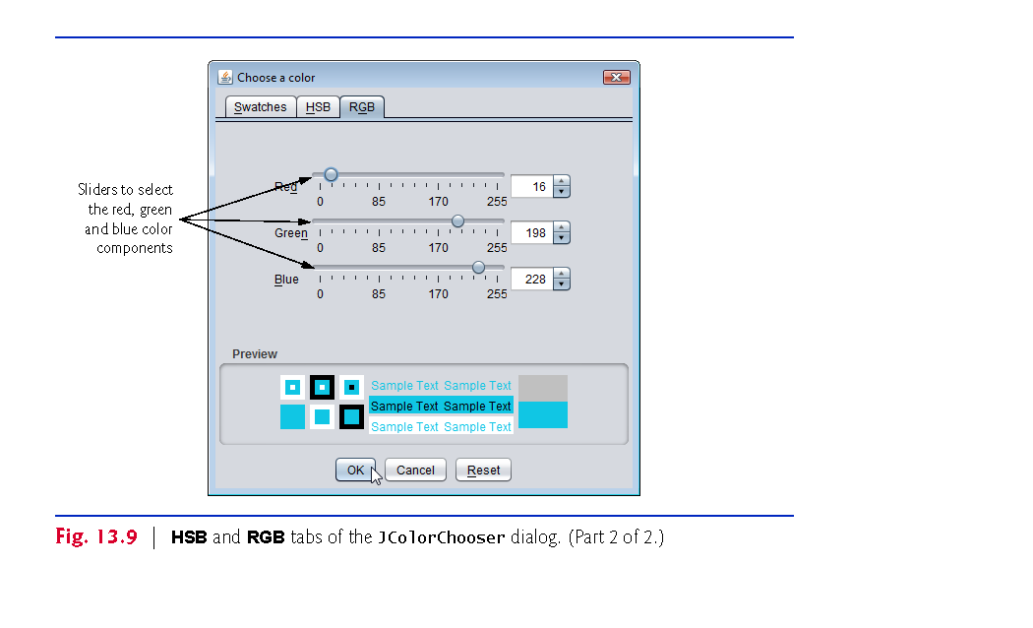
© Copyright 1992-2015 by Pearson Education, Inc. All Rights Reserved.

Slide 14

This section presents Graphics methods for drawing lines, rectangles and ovals.
The methods and their parameters are summarized in Fig. 13.17.
© Copyright 1992-2015 by Pearson Education, Inc. All Rights Reserved.

Slide 15
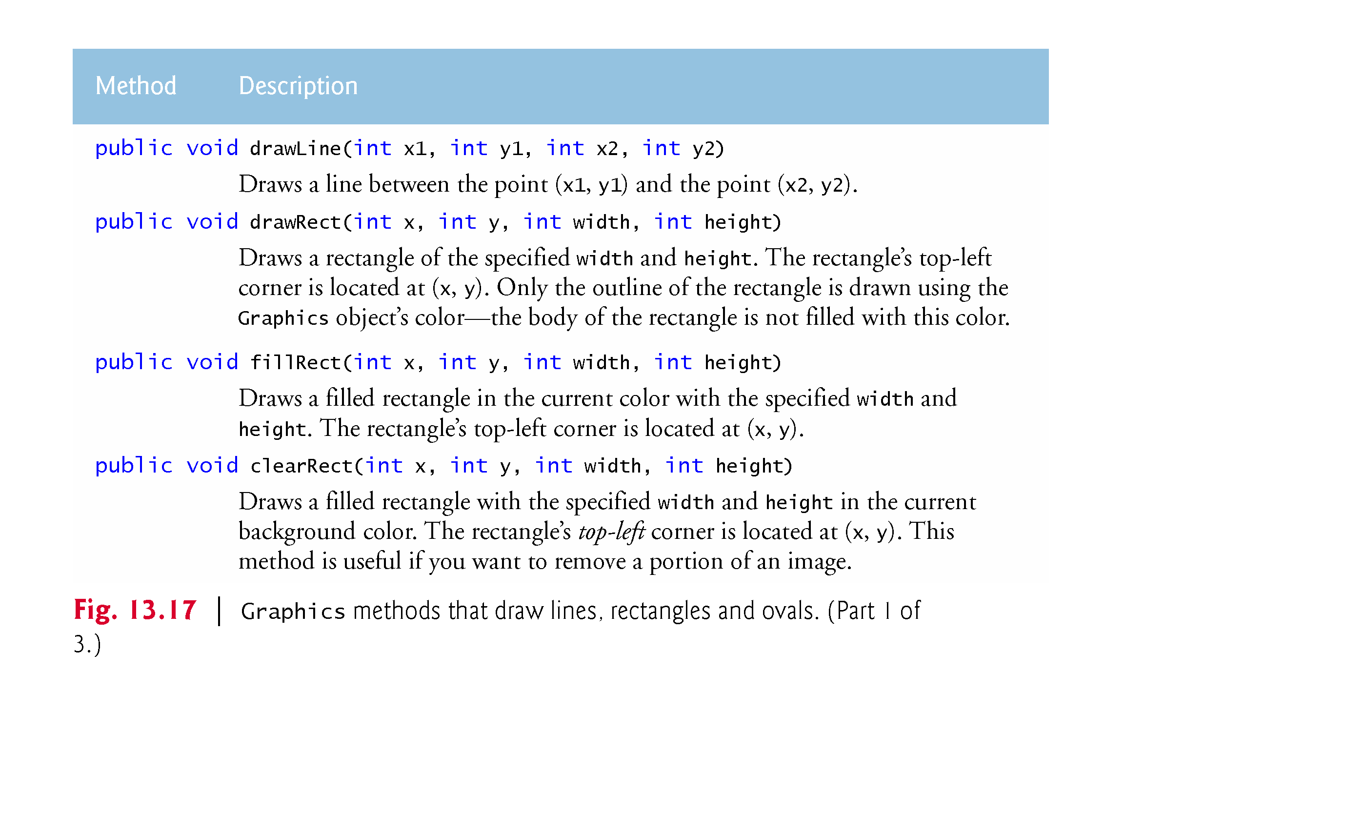
© Copyright 1992-2015 by Pearson Education, Inc. All Rights Reserved.

Slide 16
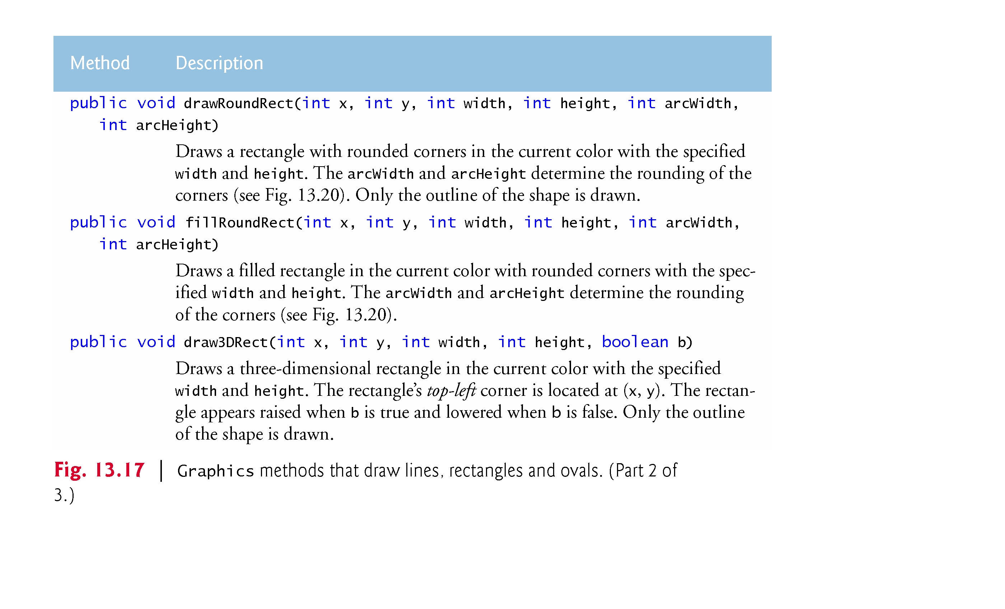
© Copyright 1992-2015 by Pearson Education, Inc. All Rights Reserved.

Slide 17
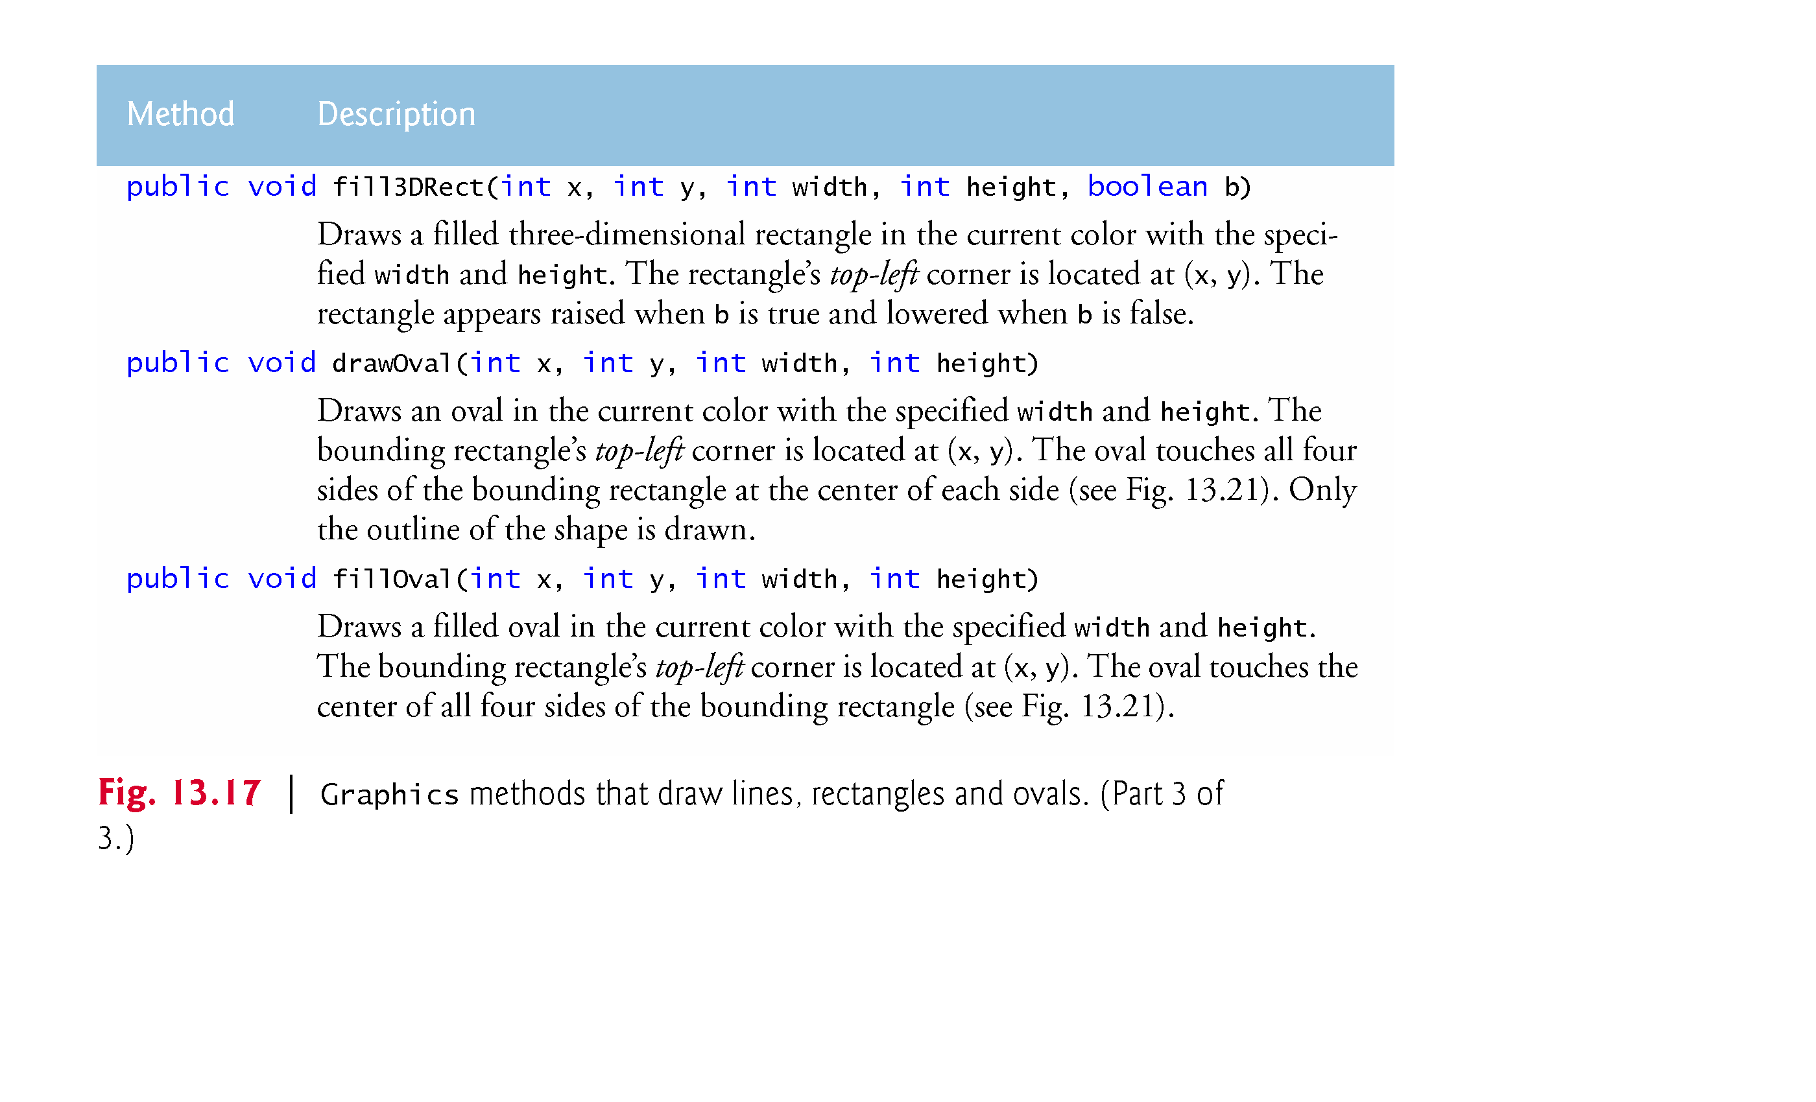
© Copyright 1992-2015 by Pearson Education, Inc. All Rights Reserved.

Slide 18
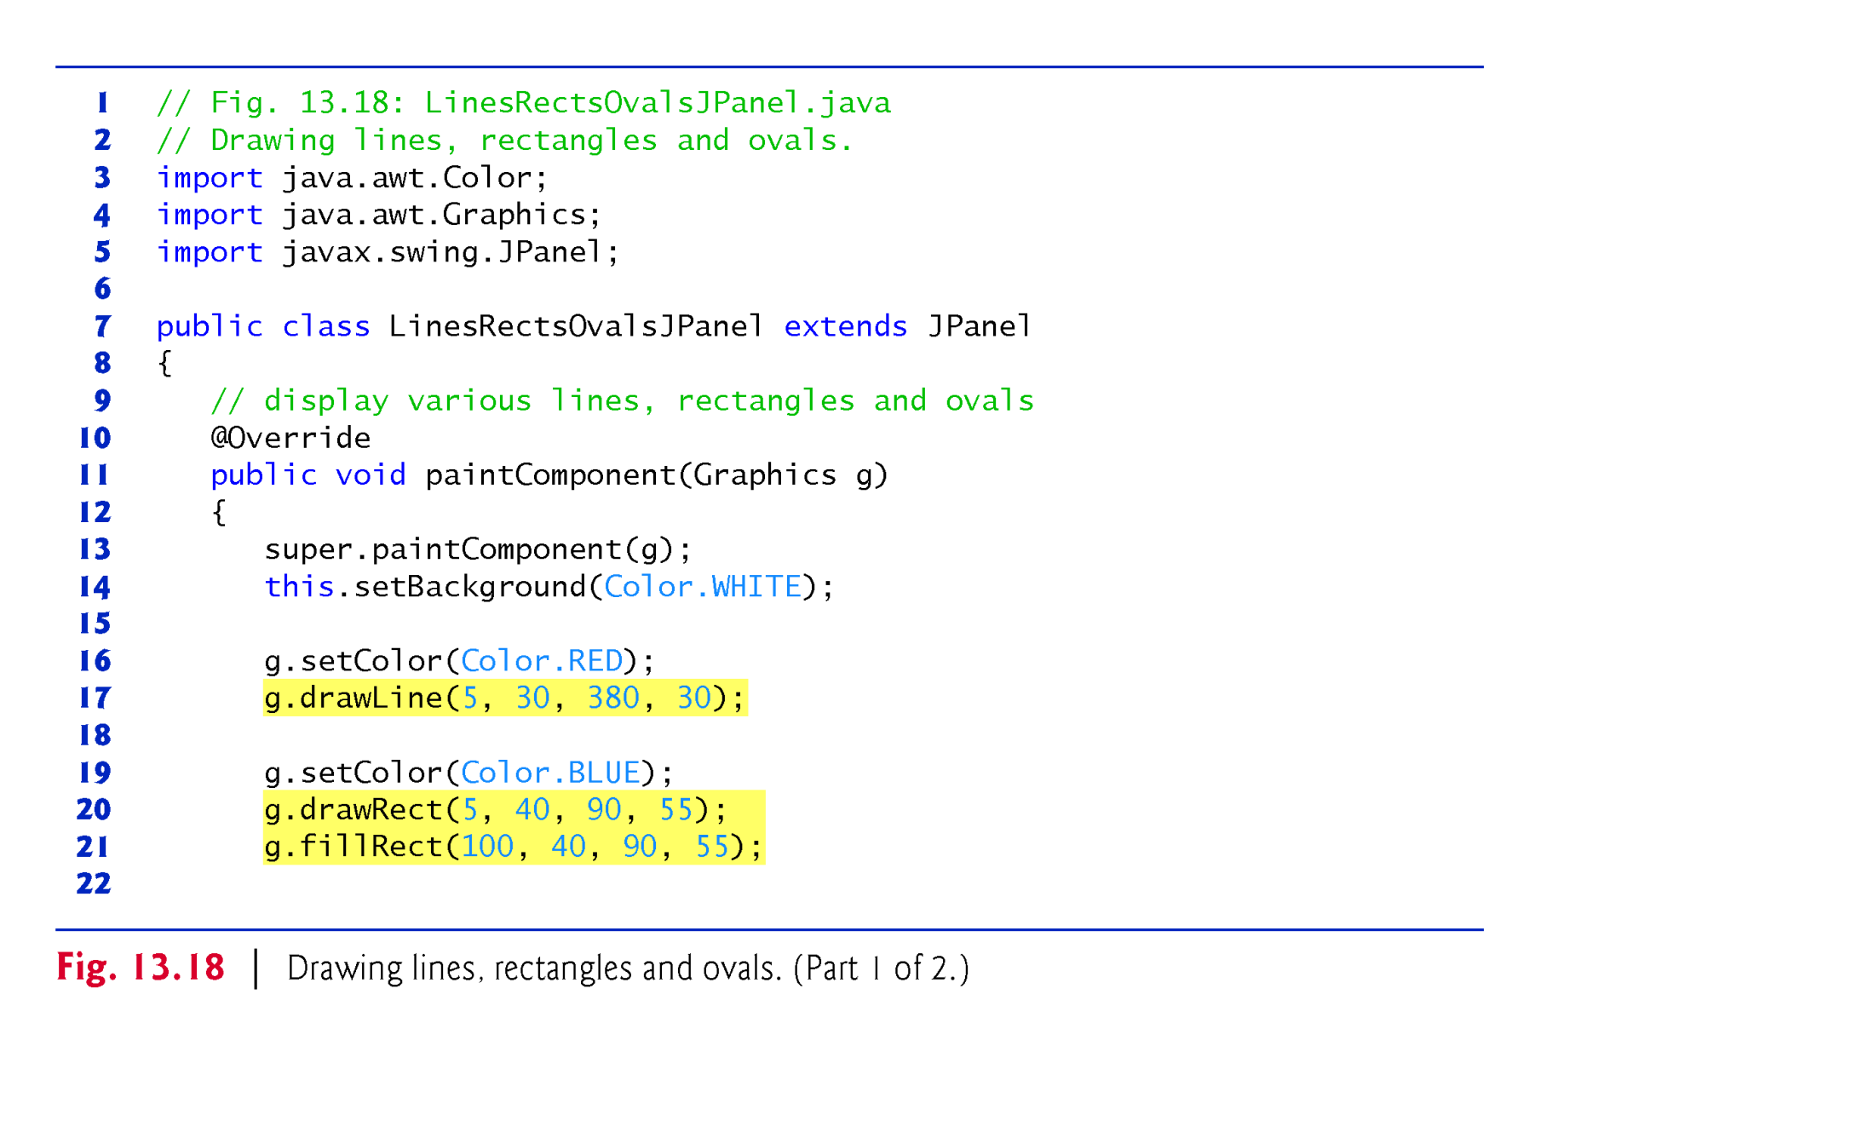
© Copyright 1992-2015 by Pearson Education, Inc. All Rights Reserved.

Slide 19
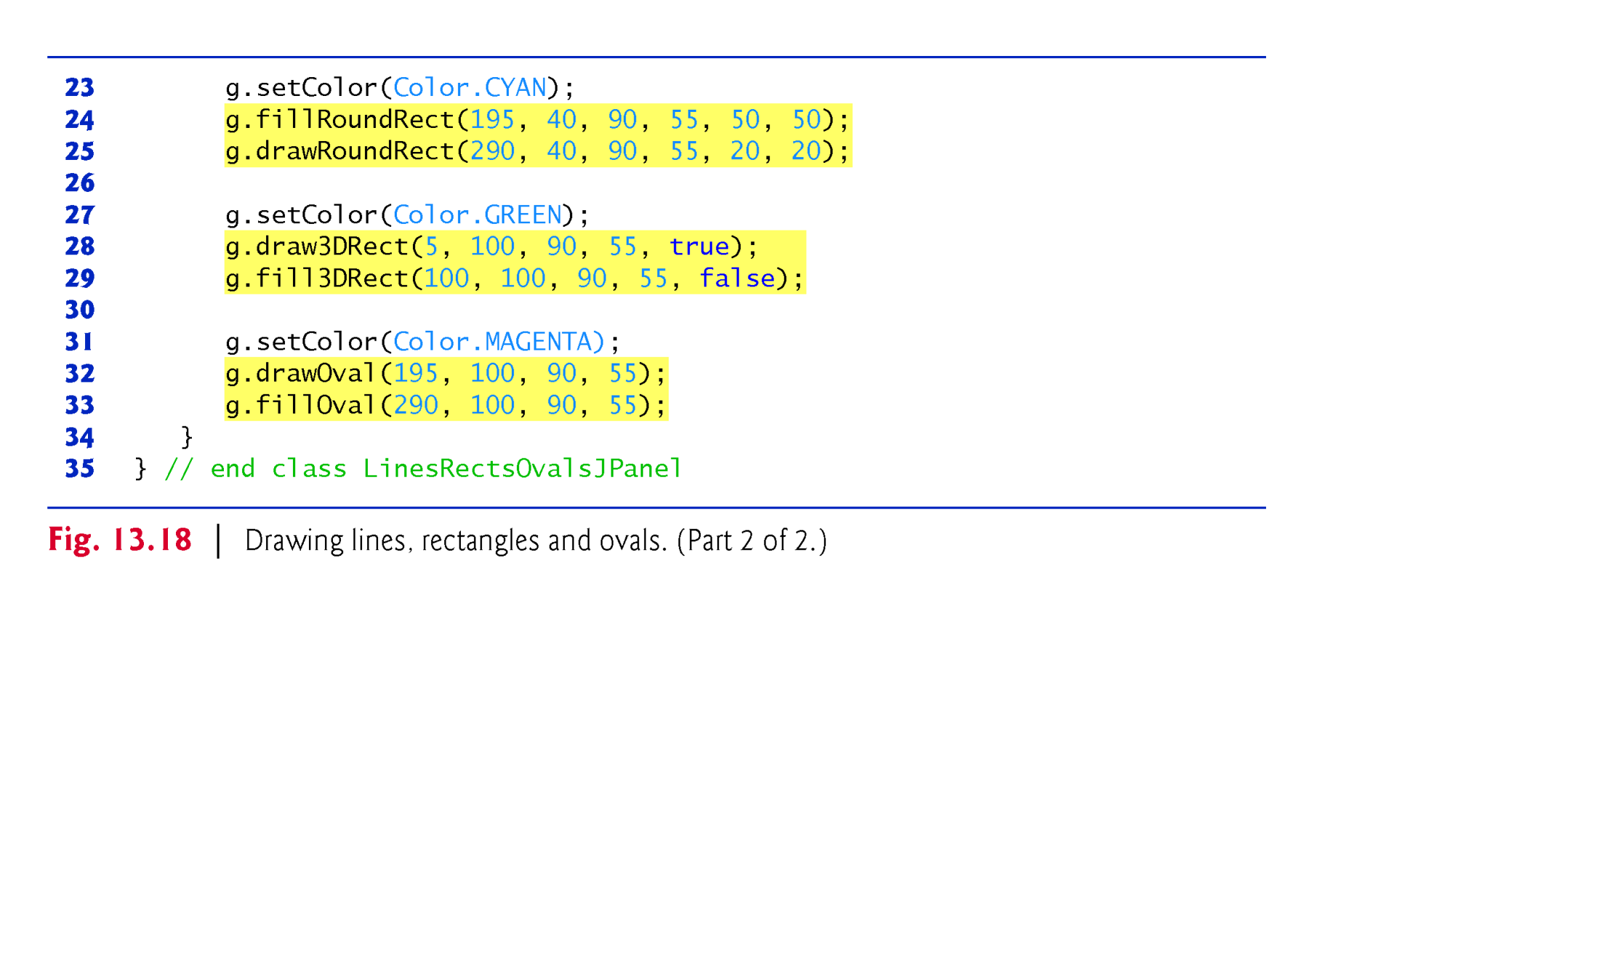
© Copyright 1992-2015 by Pearson Education, Inc. All Rights Reserved.

Slide 20
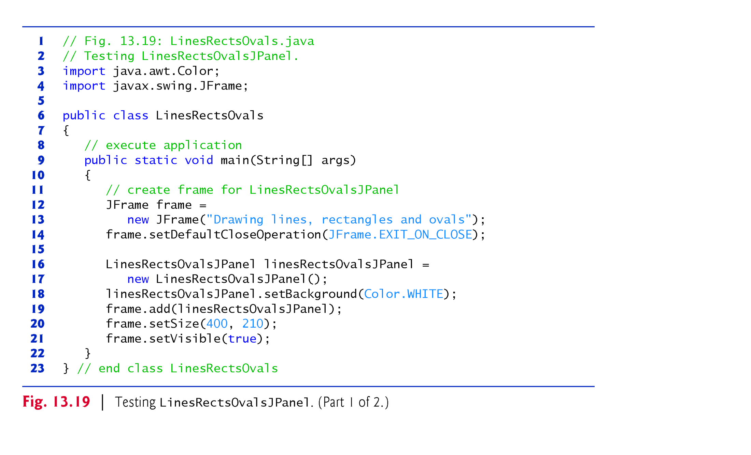
© Copyright 1992-2015 by Pearson Education, Inc. All Rights Reserved.

Slide 21
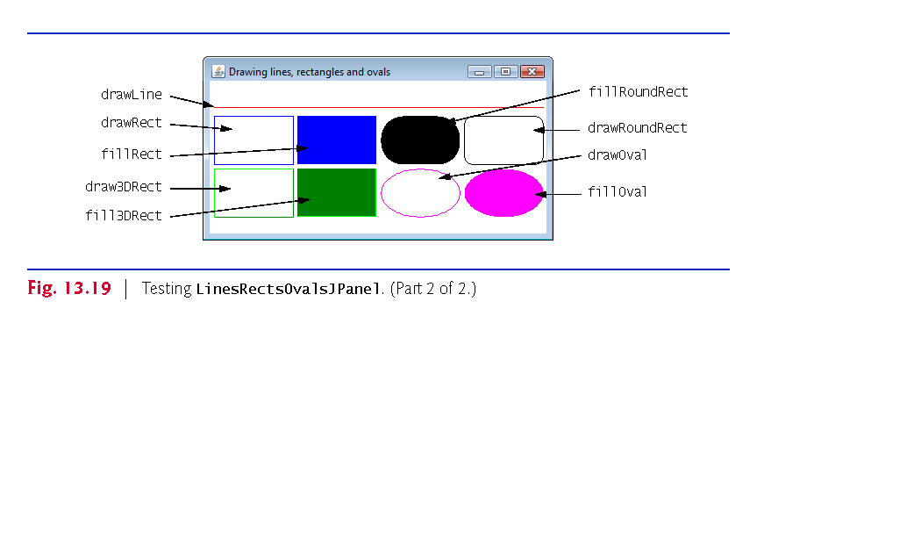
© Copyright 1992-2015 by Pearson Education, Inc. All Rights Reserved.

